Slide 1
HEAT AND RUBBING METHOD
(HRM)
An Advanced Concrete Recycling Technology
UNDER THE GUIDENCE OF
Asst. Prof. Akkoo Anna
PRESENTED BY
RAHUL RAVINDRAN
S7
CIVIL ENGINEERING
Roll No. 40

Slide 2
INTRODUCTION
Concrete Recycling:
Refers to the cyclic process in which concrete that has been diverted from waste streams are reused or recover for use in a new product

Slide 3
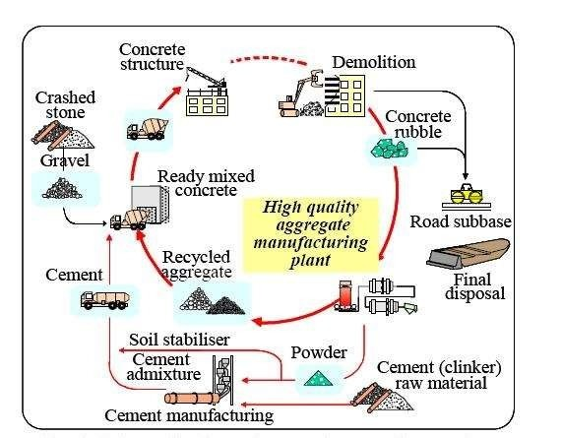
SCHEMATIC FLOW OF CONCRETE RECYCLING SYSTEM

Slide 4
Heating & Rubbing Method (HRM)
HRM is a novel technology for producing high- quality recycled aggregate.
In the HRM, demolished concrete is heated to approximately 300°C, the cement paste is made brittle by dehydration
To remove the cement paste from the surface of aggregate, the heated concrete is rubbed in a mill by media

Slide 5
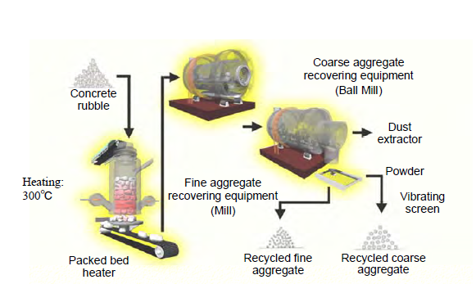
PROCESS FLOW OF THE PLANT

Slide 6
MECHANISM OF HEATING & RUBBING METHOD
Crushed concrete(50mm size)
( Heated at 300°C to 30-40 minutes)
Heated concrete
(Rubbed in primary equipment)
Coarse aggregate
(Rubbed in secondary equipment)
Fine aggregate
(Filtered out from secondary equipment)
Fine powder

Slide 7
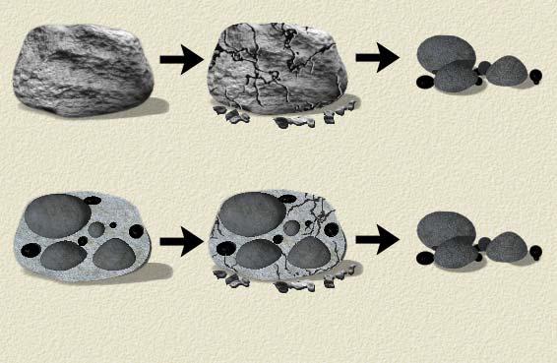
DIGRAMATIC REPRESENTATION OF HRM MECHANISM
Heating treatment
Rubbing treatment
Concrete rubble
Weakening paste
due to heating
Selective remove of paste

Slide 8
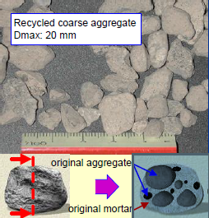
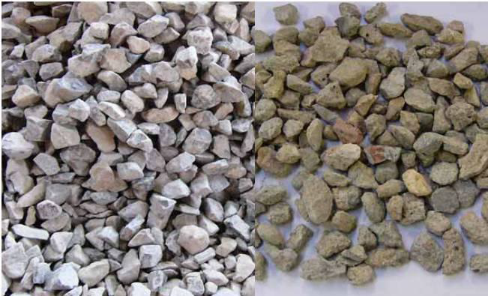
RECYCLED CONCRETE AGGREGATES
Natural crushed
aggregate
Recycled aggregate

Slide 9
PROPERTIES OF RECYCLED CONCRETE AGGREGATE
Water absorption
Strength
Size of aggregate
Porosity
Particle size distribution
Impurity level
Toughness

Slide 10
USES OF RECYCLED CONCRETE AGGREGATES
As Coarse and Fine Aggregates
- Coarse aggregate used in:
. Road base
. Sub base
. Asphalt mixtures
- Fine aggregate :
. Used in place of natural sand
. Good fill for sub-grade corrections

Slide 11
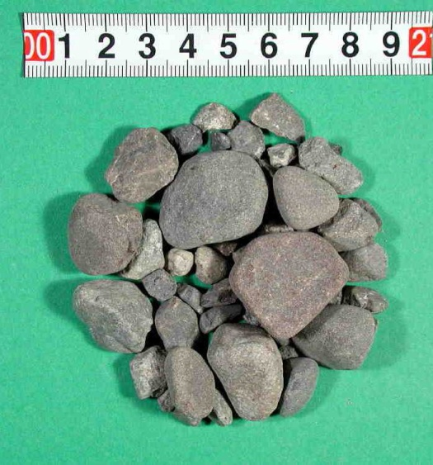
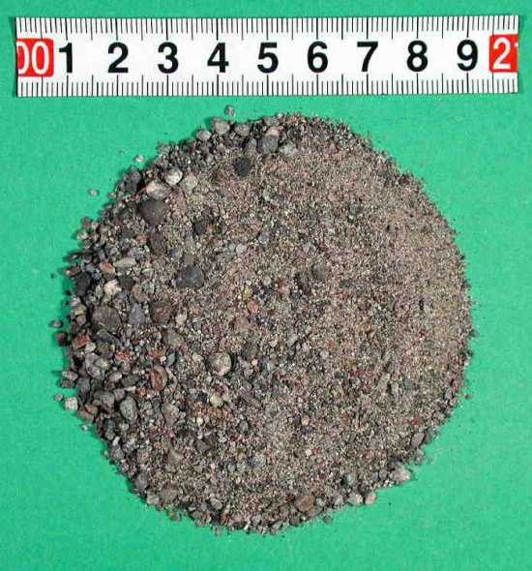
Recycled Coarse aggregate
Recycled Fine aggregate

Slide 12
Physical Limitations of Recycled Concrete Aggregate (Coarse Aggregates)
Guidelines and regulations for physical limitation of RCA in structural concrete
As per NRMCA in the US : 10% of RCA
As per UK guidelines : 20% of RCA
As per Australian guidelines : 30% of RCA
As per German guidelines : 45% of RCA

Slide 13
Utilization Of The HRM Powder
Possible uses:
• Cement material
• Ground improving material
• Addition to road bottoming
• Concrete addition
• Asphalt filler

Slide 14
Advantages of HRM
Reduction of waste, landfill or dumping
Good performance for some applications due to good compaction and density properties(for example, as road sub-base)
Reduced disposal costs
Save energy

Slide 15
Disadvantages of HRM
Non-regular supply of construction and demolished waste
Low economic cost of natural aggregate
For specialized application (e.g. high performance concrete), there are some limitations on fitness for use.

Slide 16
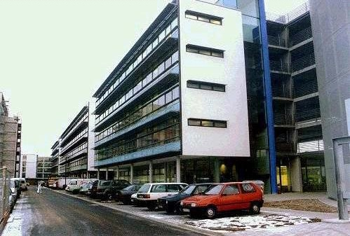
Examples Of Application
1. Vilbeler Weg office building, Darmstadt, Germany

Slide 17
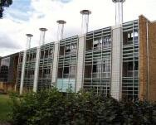

2. The BRE office building in Watford, UK
3. Waldspirale residential building in Darmstadt,
Germany

Slide 18
CONCLUSION
A subsidy for the production of high-quality recycled aggregate is very effective by the introduction of the HRM method
To increase the HRM treatment , the HRM powder should be used efficiently as cement admixture
Properties for recycled concrete aggregate are lower compared to natural aggregate

Slide 19
REFERENCE
Yoshioka, M., Matsuhashi, R. and Ishitani, H. (1998). “Study of methodology for life cycle assessment using related process model.” International Journal of Global Energy Issues,11.
Shima, H., Matsuhashi, R., Yoshida, Y. and Tateyashiki,H. (2003a). “Life Cycle Analysis of High Quality Recycled Aggregate Produced by Heating and RubbingMethod.” IEEJ Trans. EIS, 123-C (10),1680-1687. (in Japanese)
Tateyashiki, H., Shima, H., Matsumoto, Y. and Koga, Y. 2001). “Properties of Concrete with High Quality Recycled Aggregate by Heat and Rubbing Method.” Proceedings of JCI, 23 (2). (in Japanese)
Tateyashiki H., Okamoto M., Nishimura Y., Kuroda Y.; Experimental studies on production of high quality recycle aggregate from demolished concrete, Proc. of
the Japan Concrete Institute, Vol.22.

Slide 20


